Slide 1
772 Initial Proposal
Multicycle CPU with Approximate ALU

Slide 2
Goals
Stretch Goals
16-bit multi-cycle CPU
Reconfigurable approximation block
Floating point multiplication

Slide 3
32 bit instruction set
Breakdown:
6 bit op code
5 bit Reg1 add
5 bit Reg2 add
16 bit immediate value

Slide 4
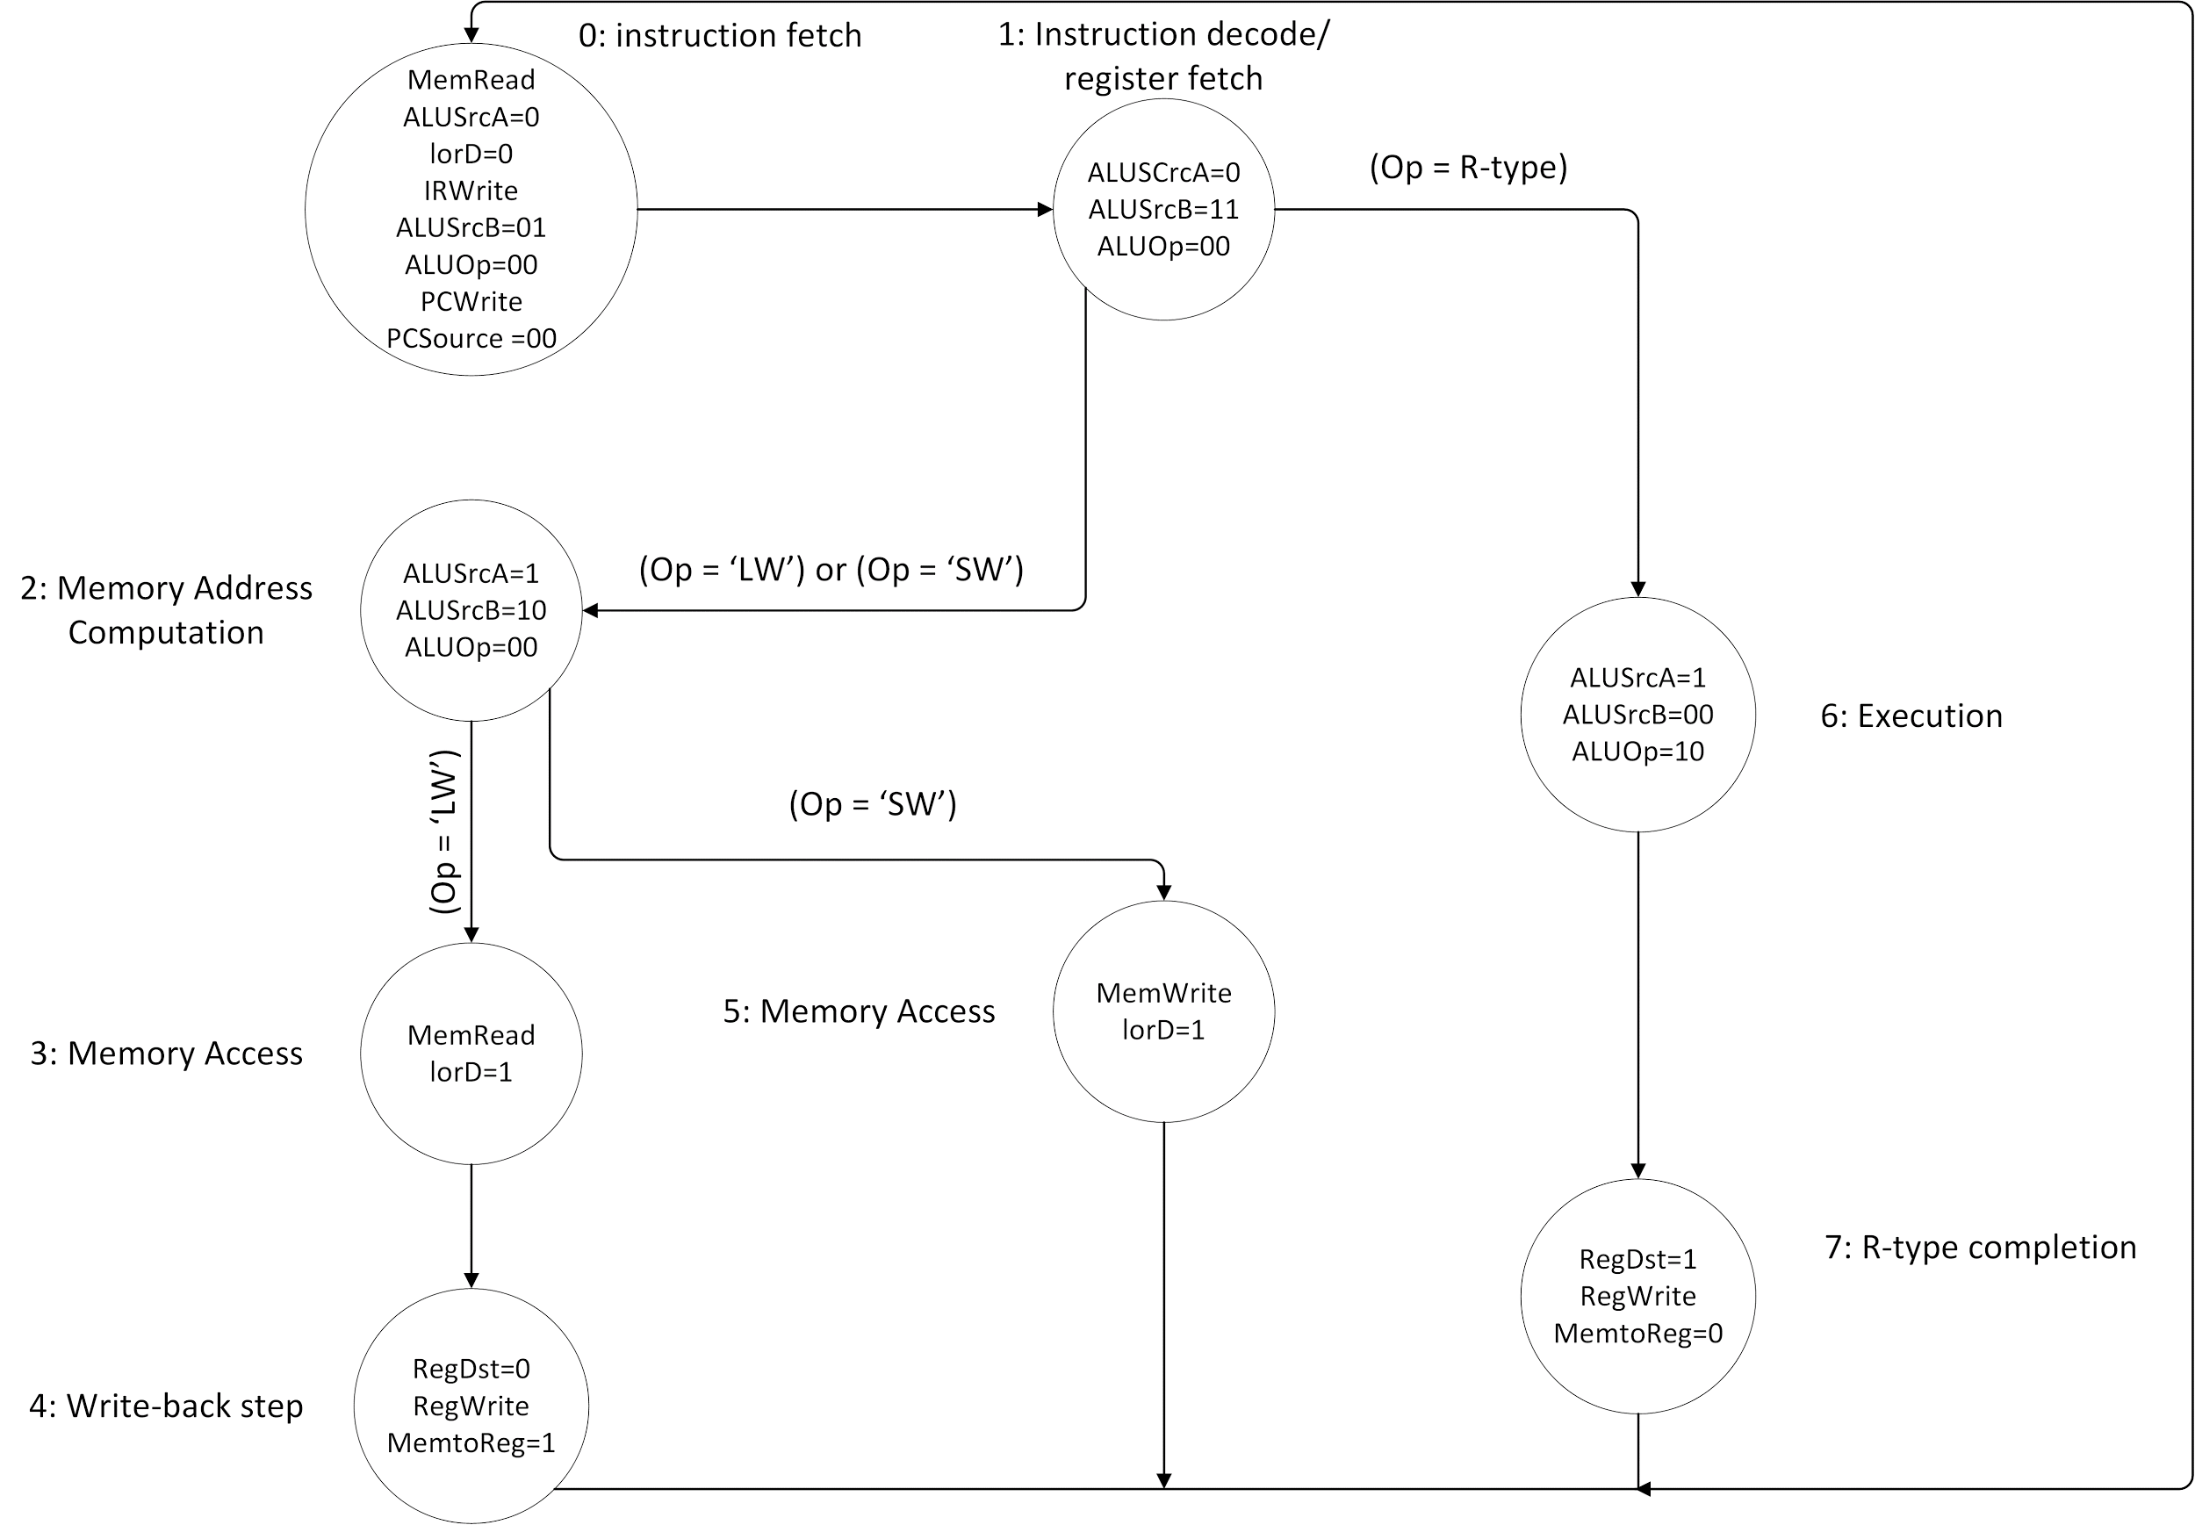

Slide 5
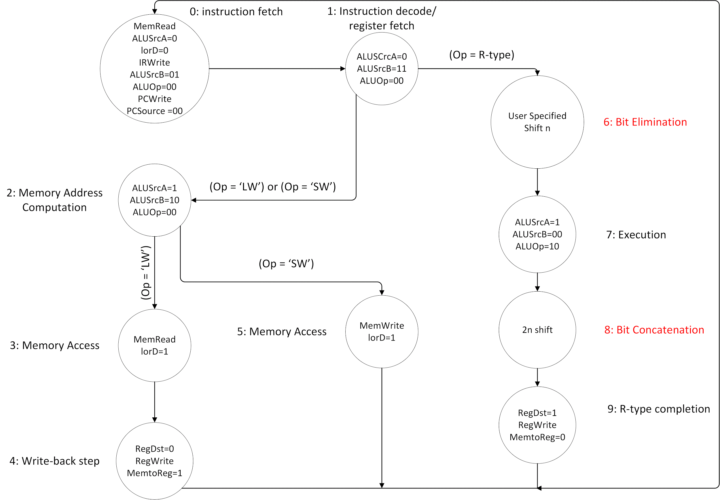

Slide 6
approximating multiplication
100000011111111
x 100000011111111
10000100000000111111000000001
=(276856321)₁₀
1000000
x1000000
1000000000000 0000000000000000
=(268435456)₁₀
Worst case loss: (276856321-268435456)/276856321 = ~3% (for losing 8 bits out of 16 bit signed integer multiplication)

Slide 7
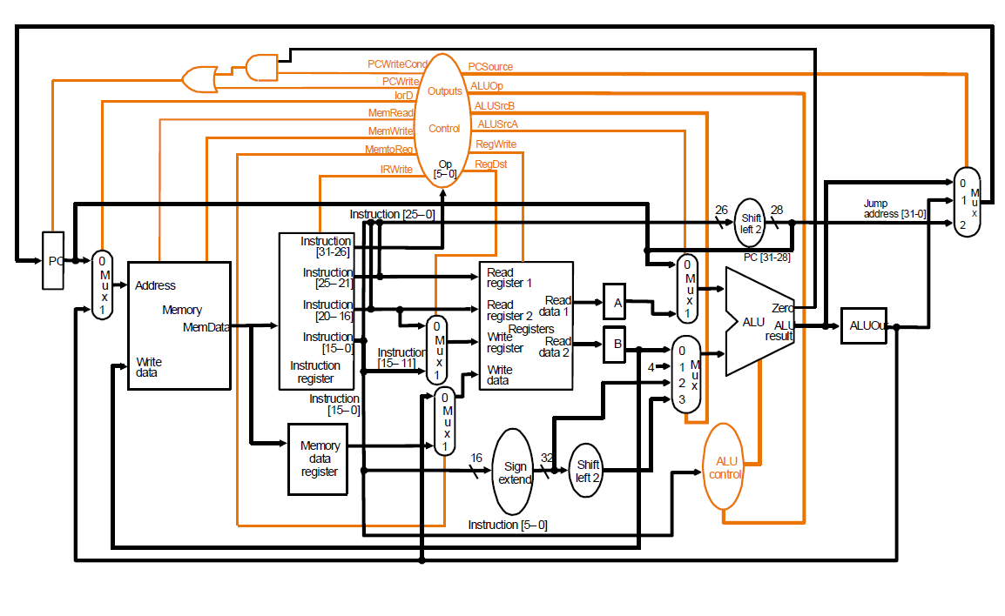

Slide 8
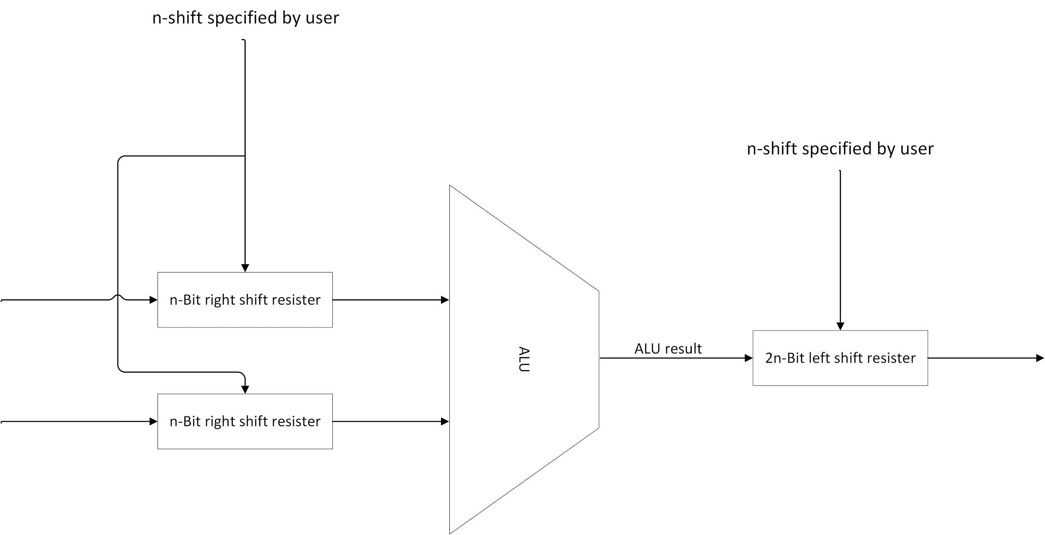

Slide 9
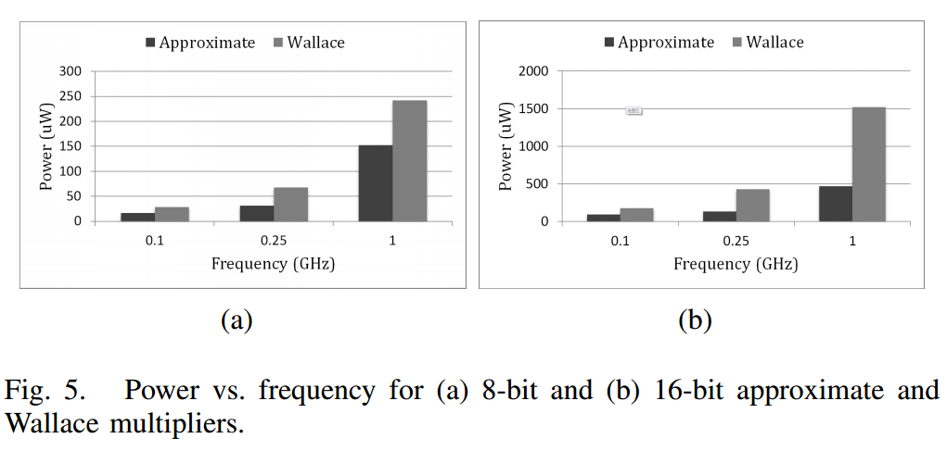

Slide 10

Timeline
Goals
February 11: Initial project proposal
March 1: Milestone 1
April 1: Milestone 2
April 29: Milestone 3
Simulation of regular CPU using Xilinx ISE.
Complete design and simulation of approximate ALU block.
Complete the design flow steps of the CPU with approximate ALU. Generate EDIF file.
Start working on floating point multiplication.
Power comparison of the two CPUs [normal and approx].
Final report and presentation

Slide 11
Reference
Liu, Cong, Jie Han, and Fabrizio Lombardi. "A Low-power, High-performance Approximate Multiplier with Configurable Partial Error Recovery." Design, Automation & Test in Europe Conference & Exhibition (DATE), 2014 (2014): n. pag. Web.
Slides 7 and 4 taken from EC551, Prof. Martin C Herbordt

